Slide 1
Ecosystem Indicator Report Analyses

Slide 2
Section: Ecosystem Change
Evidence that we are at the beginning of a “cold wave” in the Gulf of Maine (Record et al. 2024, Oceanography)
PHTG: Annual average anomaly 0.2°C above 2003-2020 CRP
PHTG: Winter (Dec 24-Feb 25) average anomaly 0.5°C below CRP
PHTG: All seasons coolest since 2019

Slide 3
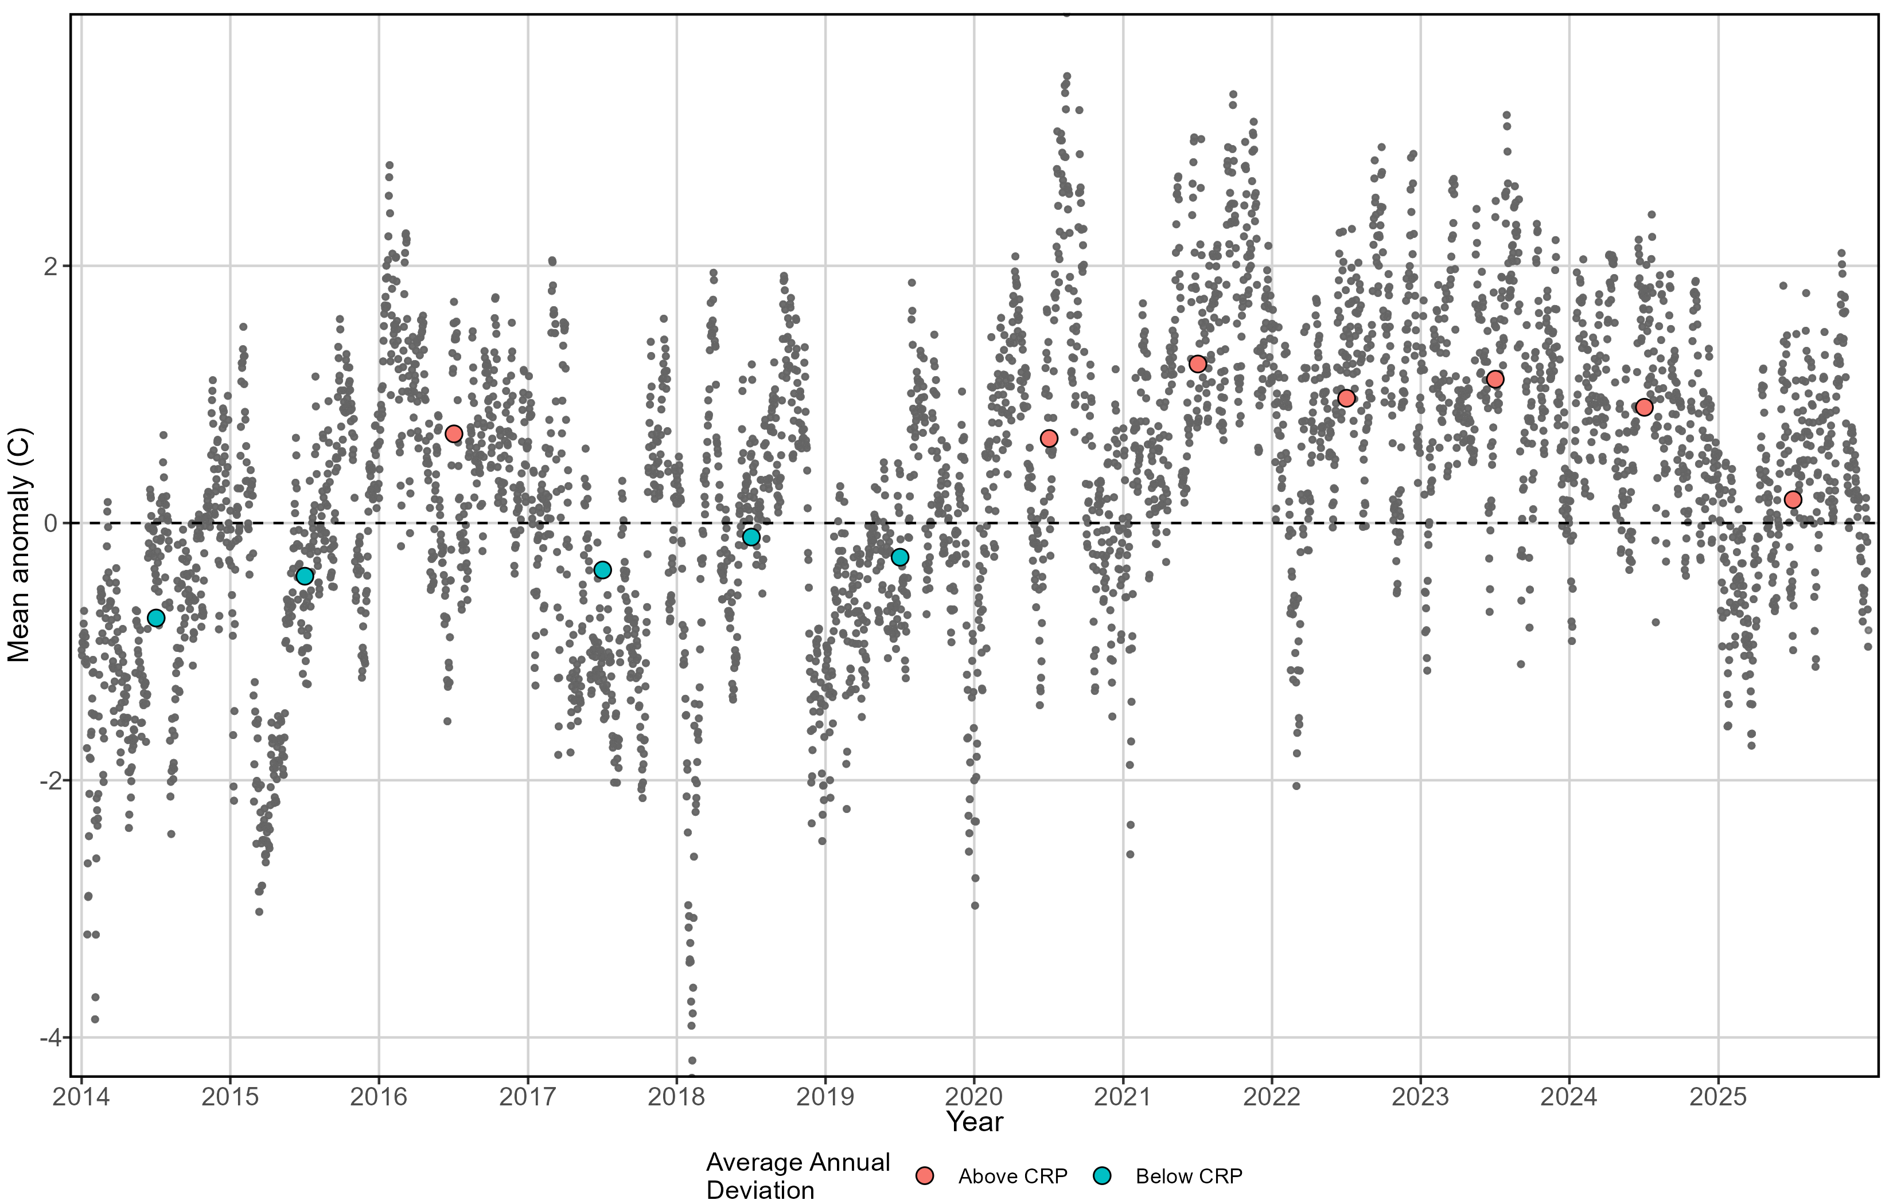
Section: Ecosystem Change

Slide 4
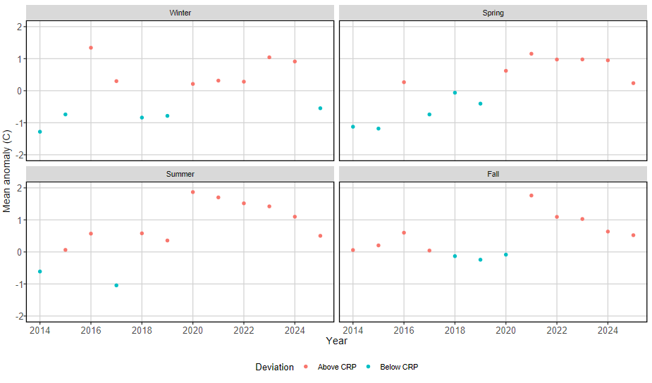
Section: Ecosystem Change

Slide 5
Section: Ecosystem Change
New: HOBO data loggers deployed to record bottom water temperature at each site

Slide 6
Section: Species of note
Southern orphans – spot*, permit
* New this year, captured consistently at Lowell Cove Jul-Aug
No other GSOs or “southern species”
White mullet disappeared after catch increases since 2022
No crevalle jack either (consistently caught since 2020)

Slide 7
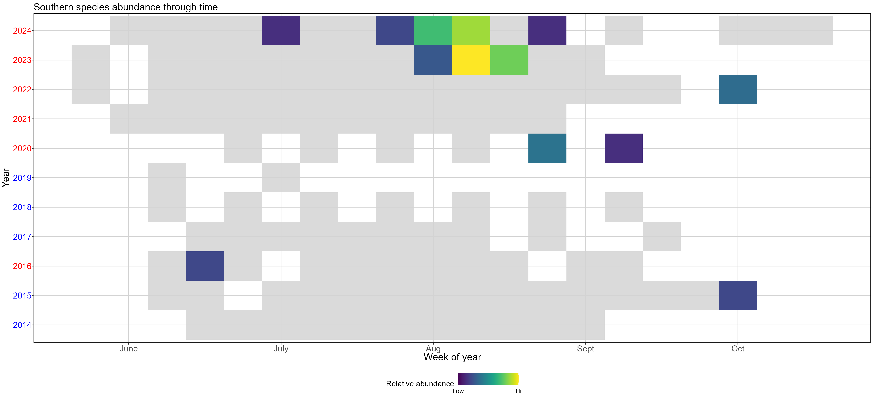
Section: Species of note

Slide 8
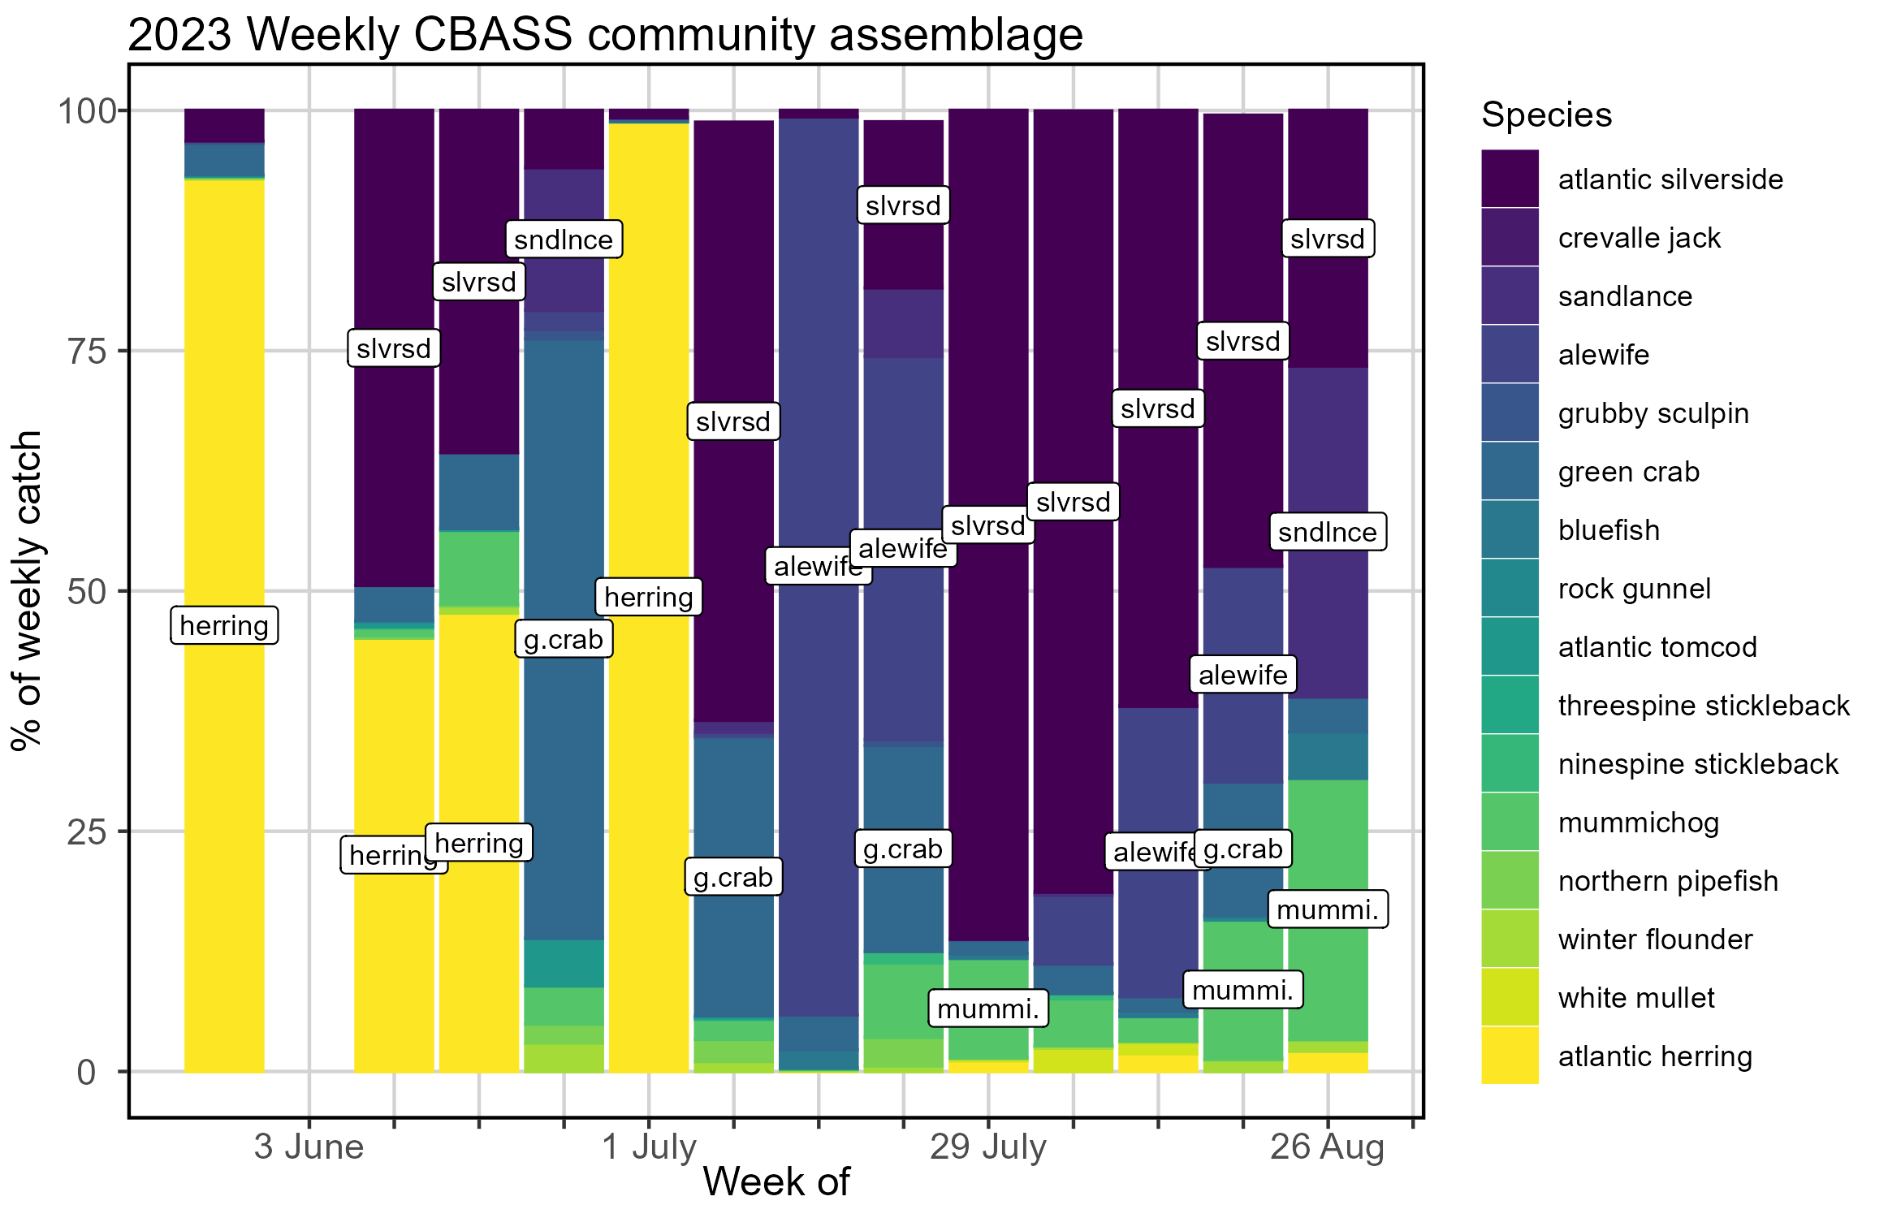
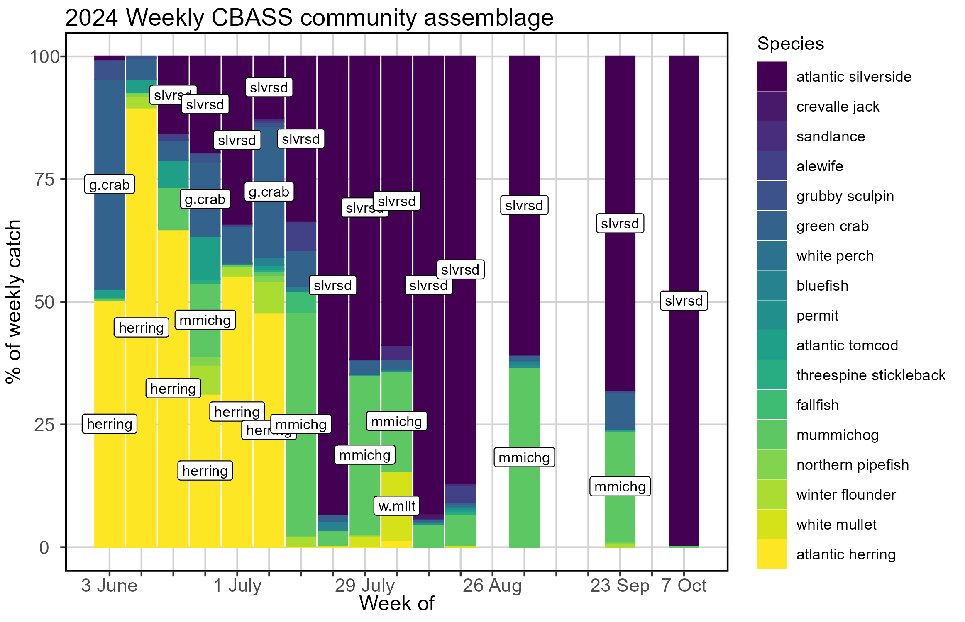
Section: Species of note

Slide 9
Section: Emergent Trends
Increased Atlantic tomcod abundance as compared to previous years, related to temperature

Slide 10
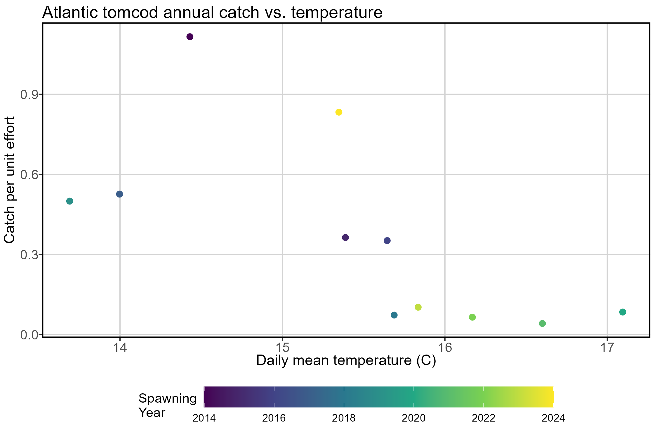
Section: Emergent Trends
Notes:
GMRI tomcod only
Used spawning year (Nov-October)
Other stuff I tried: winter/ early spring precipitation, winter/ early spring Presumpscot river height (proxy for flow), seasonal temperatures, instantaneous temperature (sonde, data missing and/or uncalibrated)

Slide 11
Section: Emergent Trends
Delayed spawning for estuarine residents (Atlantic silverside, mummichog)

Slide 12
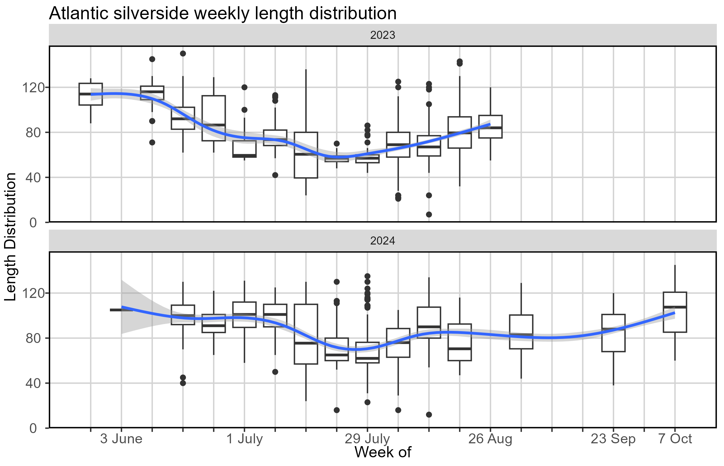
Section: Emergent Trends

Slide 13
Section: Emergent Trends
Increased Atlantic silverside growth and decreased Atlantic herring growth in warmer conditions
QBC student involvement on this project

Slide 14
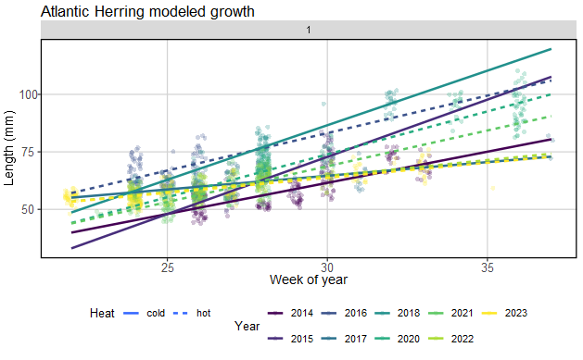
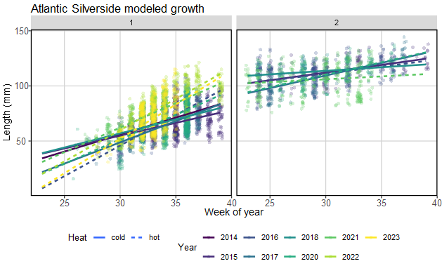
Section: Emergent Trends

Slide 15
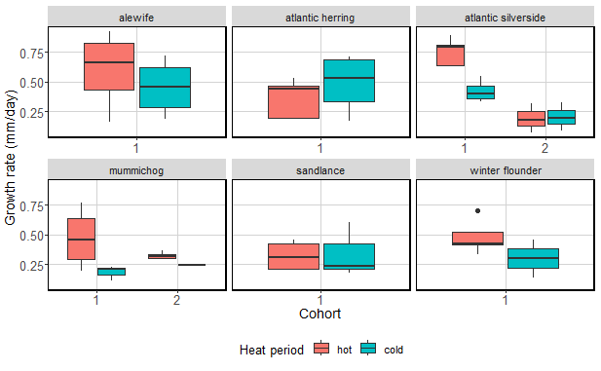
Section: Emergent Trends

